Slide 1

Bottom-up Approach
V2G-Sim Model Architecture
Includes libraries of models of varying complexity & computing time
Core objective: a platform to develop and test any user-defined charge/discharge control approach and co-simulate with complementary models (e.g. distribution, transmission, market, etc.)
V2G-Sim models the driving and charging of many individual vehicles to temporally and spatially predict how vehicles can benefit the electricity grid and how the grid
affects vehicles
e⁻
$

Slide 2
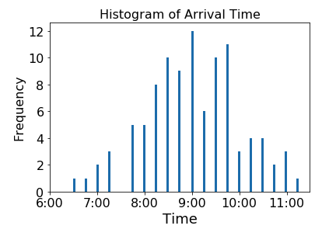
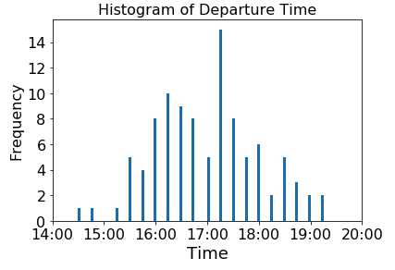
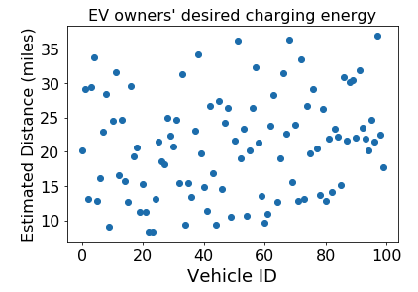
Case study: Energy cost saving + demand charge mitigation
Real-world commercial building load and 100 EV travel data from CEC-LBNL Alameda County demonstration project.
100 PEVs with 6.6kW chargers; PG&E E-19 commercial user tariff.
Building owners aims to minimize total charging cost and demand charge cost by perform smart charging algorithm, without compromise energy demand from EV owners

Slide 3
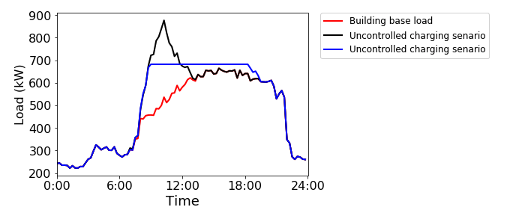
Simulation Results:
If we use stationary battery storage to achieve the same effect:
We need, 100kwh and 200kw
Using tesla power pack price, the cost would be : $40,000
Senarios | Energy charge | Demand charge | total
Base load
Uncontrolled charging
Controlled charging

